Slide 1
PREDICTION OF ENERGY PRODUCTION FOR COMBINED CYCLE POWER PLANT
BY: Chinmaya
Sarvesh
Vidya Chavan
Shraddha Waghode
Meghana
Upparapalli
Shubhdarshini

Slide 2
Architecture
Understanding Business Objective
Exploratory Data Analysis
Model Building
Model Evaluation
Feedback
Deployment

Slide 3
BUSINESS OBJECTIVE
A combined-cycle power plant comprises gas turbines, steam turbines, and heat recovery steam generators. In this type of plant, the electricity is generated by gas and steam turbines combined in one cycle. Then, it is transferred from one turbine to another.
We have to model the energy generated as a function of exhaust vacuum and ambient variables and use that model to improve the plant's performance.

Slide 4
VARIABLES OR FEATURES :
Temperature, in degrees Celsius.
Exhaust vacuum, in cm Hg.
Ambient pressure, in millibar. (Ambient pressure) Independent
r_humidity, in percentage. (Relative humidity) Variables
Energy_production, in MW, net hourly electrical energy output. Dependent
Variable

Slide 5
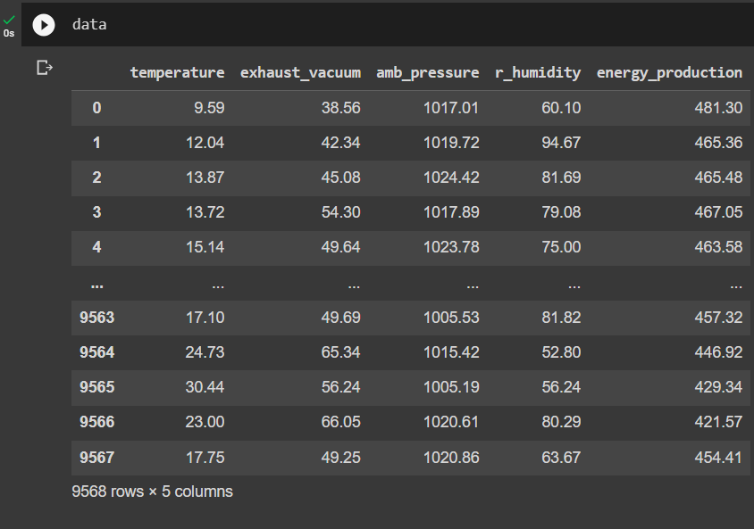
DATA SET:

Slide 6
EXPLORATORY DATA ANALYSIS (EDA)
The data types are floating point data types.
The given dataset has no null values.
The given dataset has 9568 rows and 5 column.
We found 41 duplicate values on given dataset and we cleaned that duplicate values.
Also visualize the data and check the data distribution with histplot of ‘temperature’.
From the dataset we found that Energy production is a dependent variable (Y)
Temperature, Relative Humidity, Ambient pressure, Exhaust vacuum are Independent variables(X)
Used norm() to normalize data, iloc() to store the location of data.

Slide 7
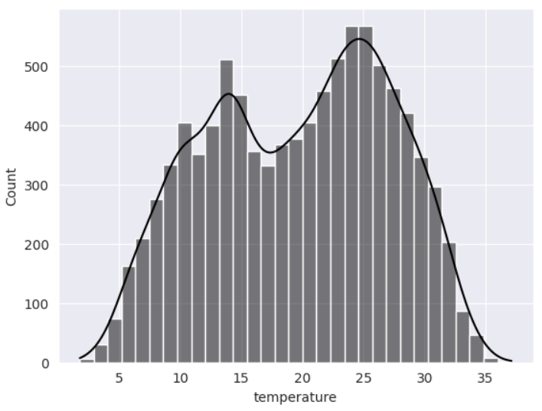
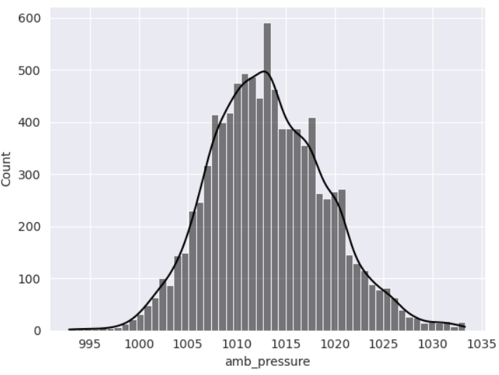
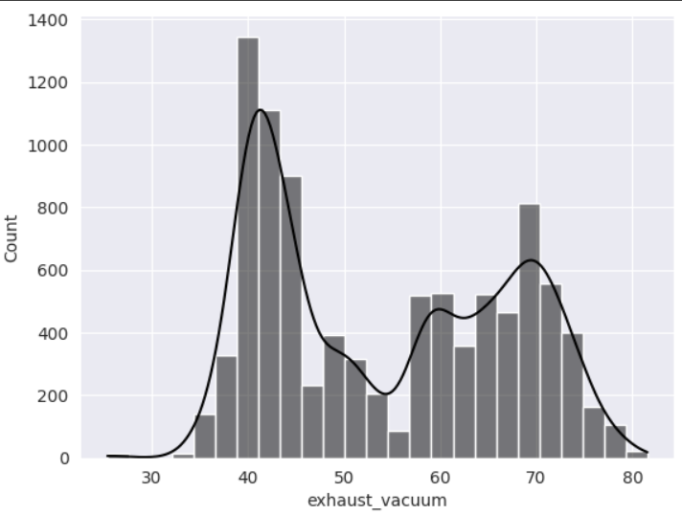

Slide 8
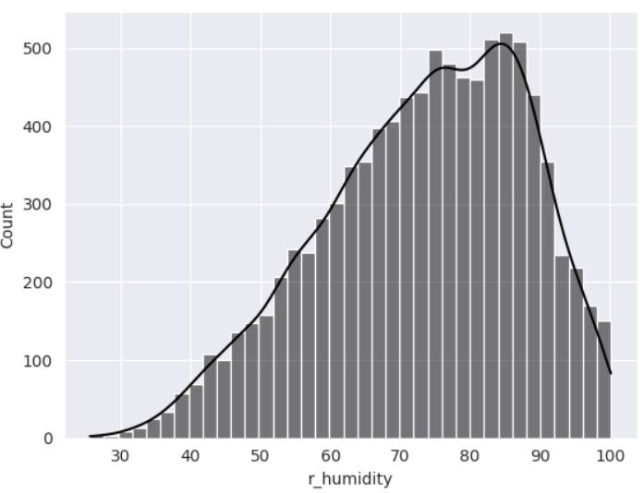
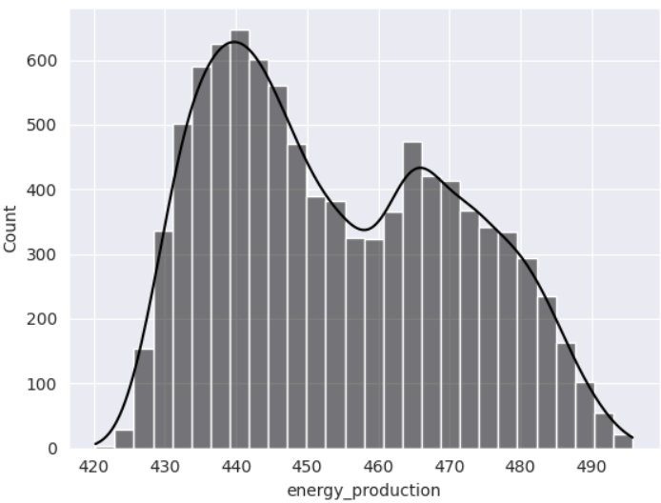

Slide 9
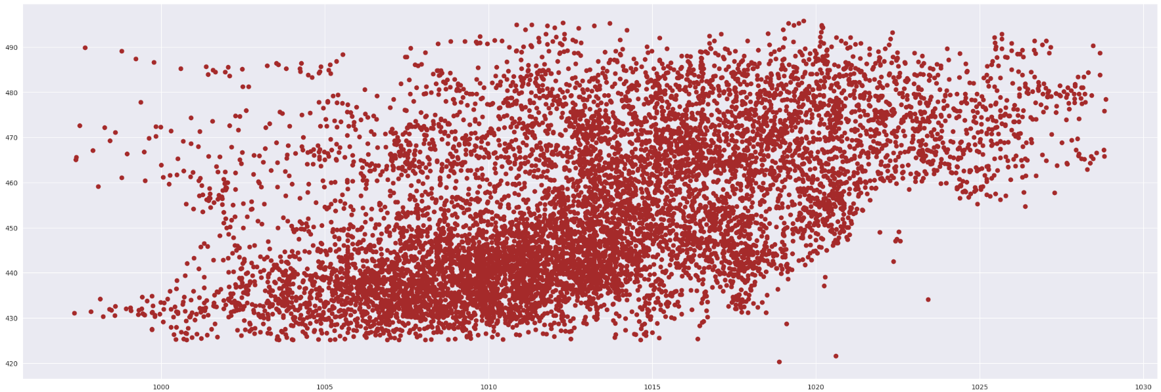
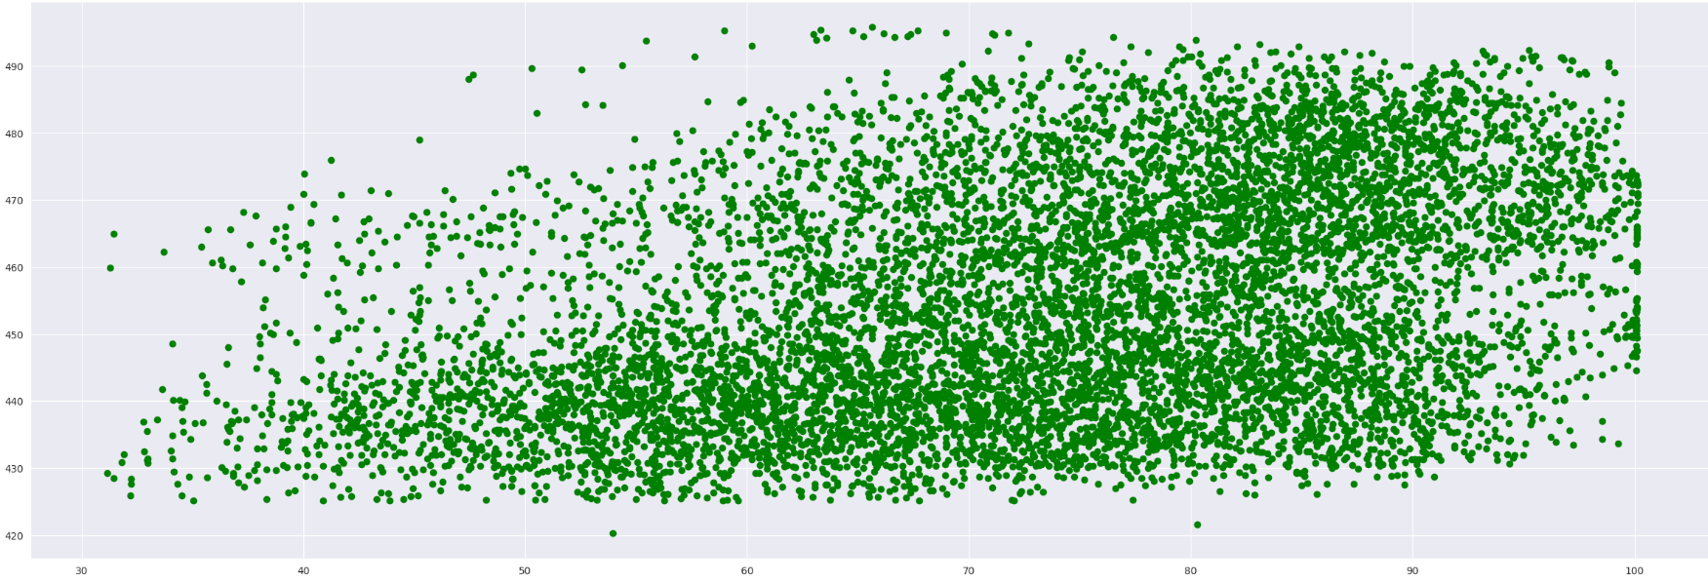

Slide 10
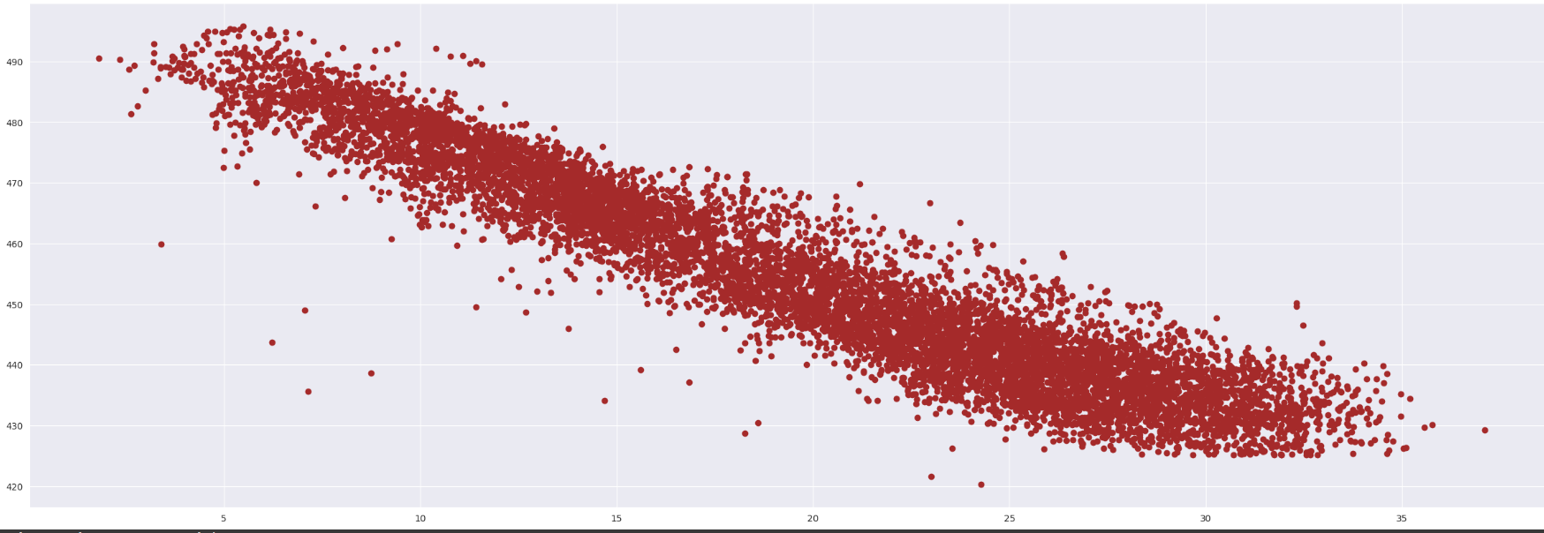
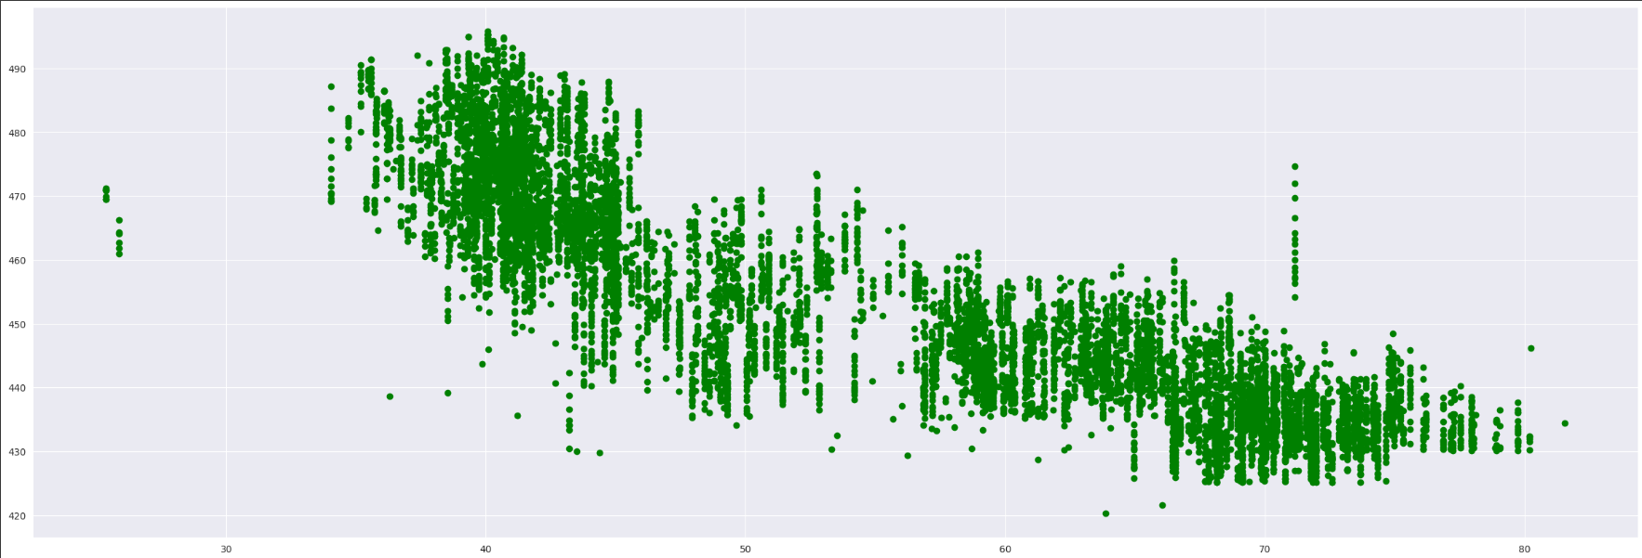

Slide 11
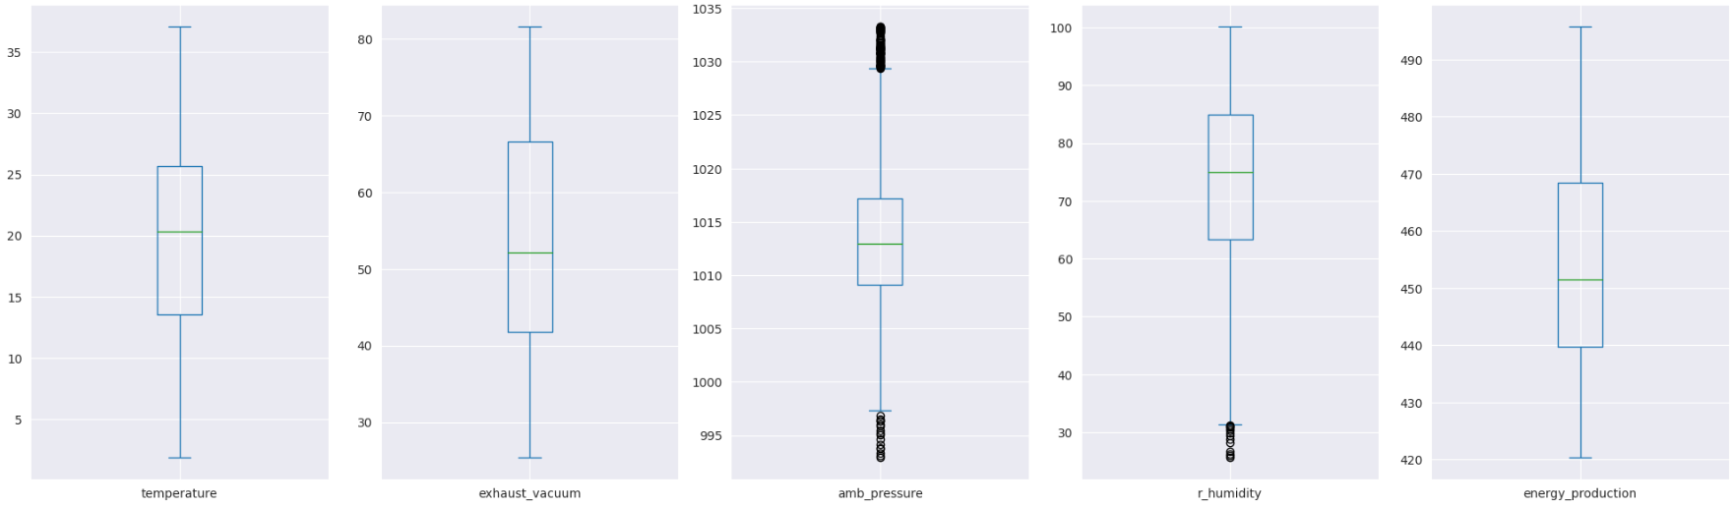
Outlier Detection: Outliers were present in amb_pressure and r_humidity, these were removed successfully. Now the dataset contain 9416 observations and 5 features.

Slide 12
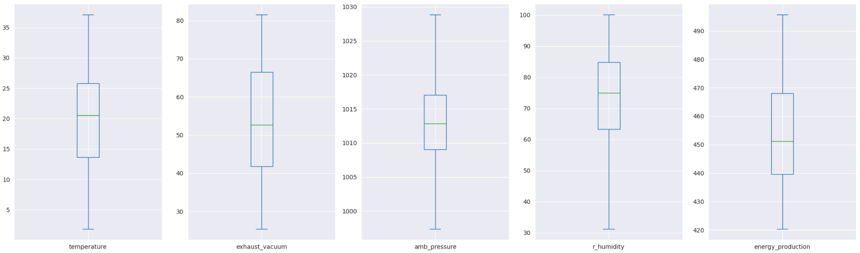
Box Plots of Variables after removing the outliers

Slide 13
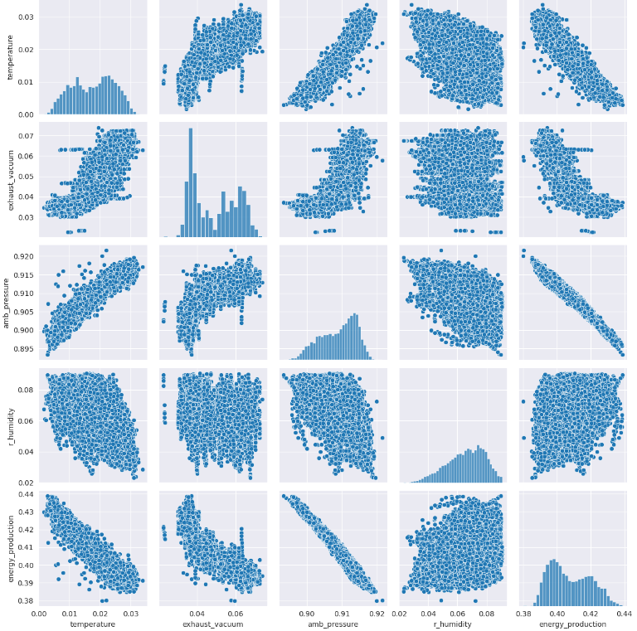
Correlation among the variables: From these scatter plots, temperature shows the strongest linear relationship(-ve) with the hourly electrical energy output. Exhaust vacuum appears to have a linear relationship(-ve), though at a lesser extent. On the other hand, the Ambient Pressure seems to have a weak linear (+ve) correlation with the output whereas relative humidity appears to have little (+ve) to no impact on the output

Slide 14
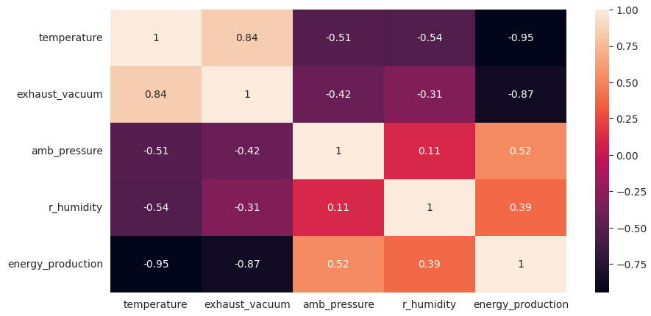
HEATMAP:

Slide 15
SKEWNESS,CORRELATION AND OUTLIERS:
Exhaust vacuum and Ambient pressure are right skewed or positive skewed.
Temperature and Relatively humidity are left skewed or negative skewed.
Energy production dependent variable is right skewed or positive skewed.
Also find outliers with some set styles.
Temperature and Exhaust vacuum are highly correlated.
We normalize data and take X is independent variable and Y is dependent variable.

Slide 16
Normalization:
Normalization of data is carried out to bring all the observations on same scale.
Splitting the data set:
1. X – independent variables and Y- dependent variable
2. Data is splitted in Train and test
Train dataset- containing 7532 observations and 4 variables
Test dataset- containing 1884 observations and 4 variables

Slide 17
Split The Data Into X and Y and split into train and test
First we have to split the data into X and Y the X are the independent variables and Y is the target variable .
Then we split the data into train and test models for furthermore the data also should be given the amount of test data like 30% or 25% of data should given to the test data.

Slide 18
Standardize the Values
The data have to be Standardize because the metrics of the columns are different and it should be removed . To ensure that they have similar scale
Standardizing the values means transforming the data in such a way that the mean is zero and Standard deviation is 1.
In standardizing the train variables have to be fit and transform and the test variables should be only use transform only because preventing from data leakage. when we fit and transform both the data together we are allowing information from the test set influence on the scaling transformation.

Slide 19

Model Building 1. Random Forest Regressor
Random forest regression is a supervised learning algorithm and bagging technique that uses an ensemble learning method for regression in machine learning. The trees in random forests run in parallel, meaning there is no interaction between these trees while building the trees.
Then do the hyper parameter tuning on this model and then fit the model take the best parameters and then then take the metrics on this and then do the cross validation.
Random Forest Model Accuracy: 0.9615389435941578

Slide 20

2.Decision Tree Regressor Model
A decision Tree regressor is tree like Structure that It has a hierarchical, tree structure, which consists of a root node, branches, internal nodes and leaf nodes.
Then do the hyper parameter tuning on the parameters of the decision tree then it gives the best parameters for the decision tree regressor.
Then build the model based on it and then fit the model and then do the cross validation on it.
Decision Tree Model Accuracy: 0.9299208180876105

Slide 21

KNN Model:
KNN regression is a non-parametric method that, in an intuitive manner, approximates the association between independent variables and the continuous outcome by averaging the observations in the same neighbourhood.
hen we do take the best k values hyper parameter tunning on the k values then fit the model and take the best accuracy and then take the cross validation
KNN Model Accuracy: 0.9487927597865536

Slide 22

Gradient Boosting Regressor Model
Gradient Boosting Machine (GBM) A Gradient Boosting Machine or GBM combines the predictions from multiple decision trees to generate the final predictions.
Gradient Boosting in this we have to do the hyper parameter tunning and then we get the parameters
Then we fit the model and then do the cross validation on this then compare between the metrics of before validation and then after the validation.
Gradient Boosting Model Accuracy: 0.9463766357219642

Slide 23

Ridge Regression
Ridge regression is a model tuning method that is used to analyse any data that suffers from multicollinearity. This method performs L2 regularization.
When we do the hyper parameter tunning for the ridge on the alpha value we get the best values based on this.
Then we fit the model and get the metrics and next dot the K Fold cross validation the model and data.
Ridge Model Accuracy: 0.9288884265101333

Slide 24

Lasso Regression
Lasso regression is a regularization technique. It is used over regression methods for a more accurate prediction. This model uses shrinkage. Shrinkage is where data values are shrunk towards a central point as the mean.
We have done the hyperparameter tunning on the alpha values and get the best values on this and fit the model and then we get the values then we do the cross validation on those values.
lasso Model Accuracy: -0.00016659183966005742

Slide 25
MultiLinear Regression Model
Feature should be independent of each other there should'nt be any dependency upon each other There shouldn't be any other relation but Linear relation amongst model parameters (Hyperparameters of the model the intercept and coefficient)
Each Feature and Model Error (residuals) should be independent of each other
Constant Variance (Homoscedasticity) in Error, it should have Normal / Gaussian distribution~N(0,1) and idenpendently and identically distributed.
There should be a linear relation between the dependent variable and Independent variables

Slide 26
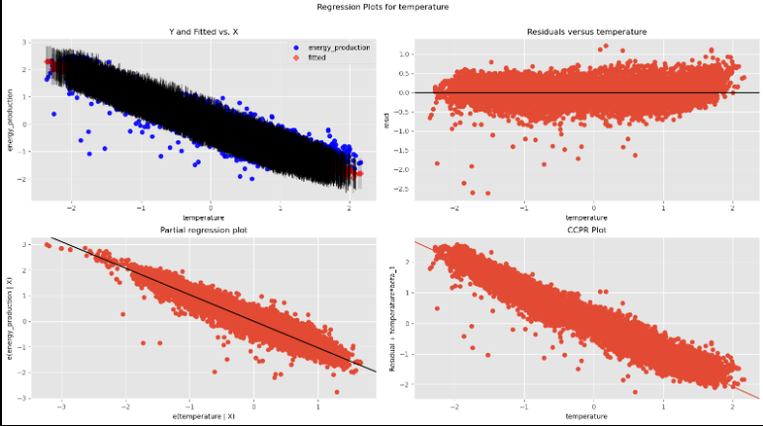
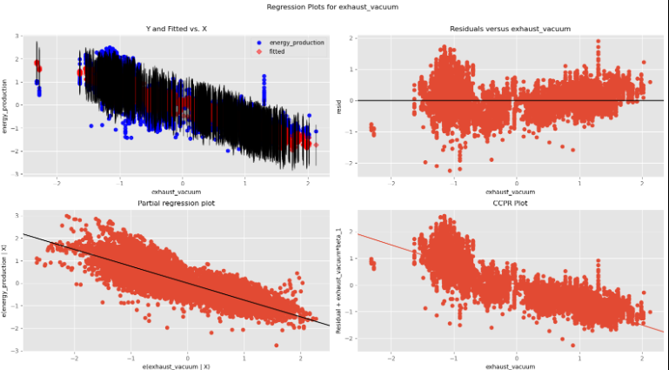
Regression plot for temperature
Regression plot for exhaust_vacuum

Slide 27
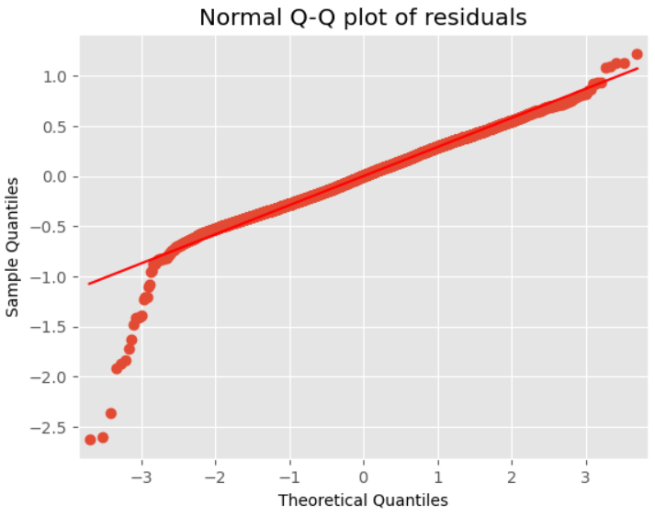
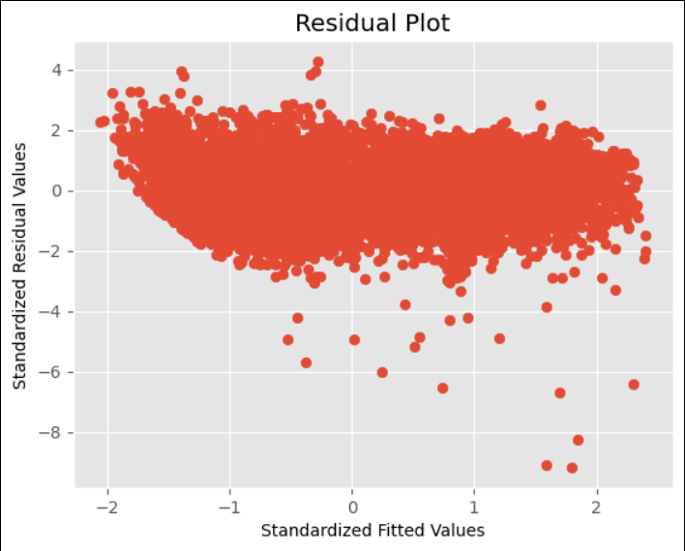
^Observation: Error should have Normal / Gaussian distribution~N(0,1) and idenpendently and identically distributed.
^Observation: Constant Variance (Homoscedasticity) in Error

Slide 28
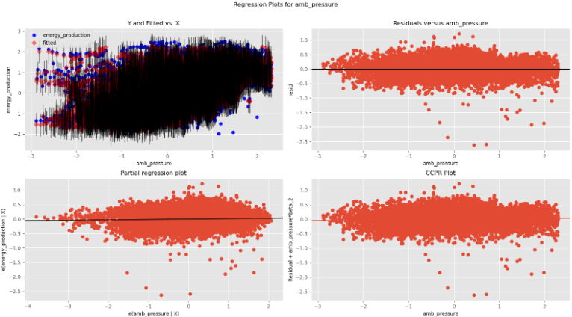
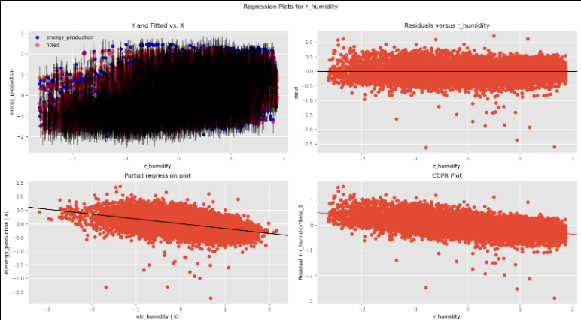
Regression plot amb_pressure
Regression plot for r_humidity

Slide 29
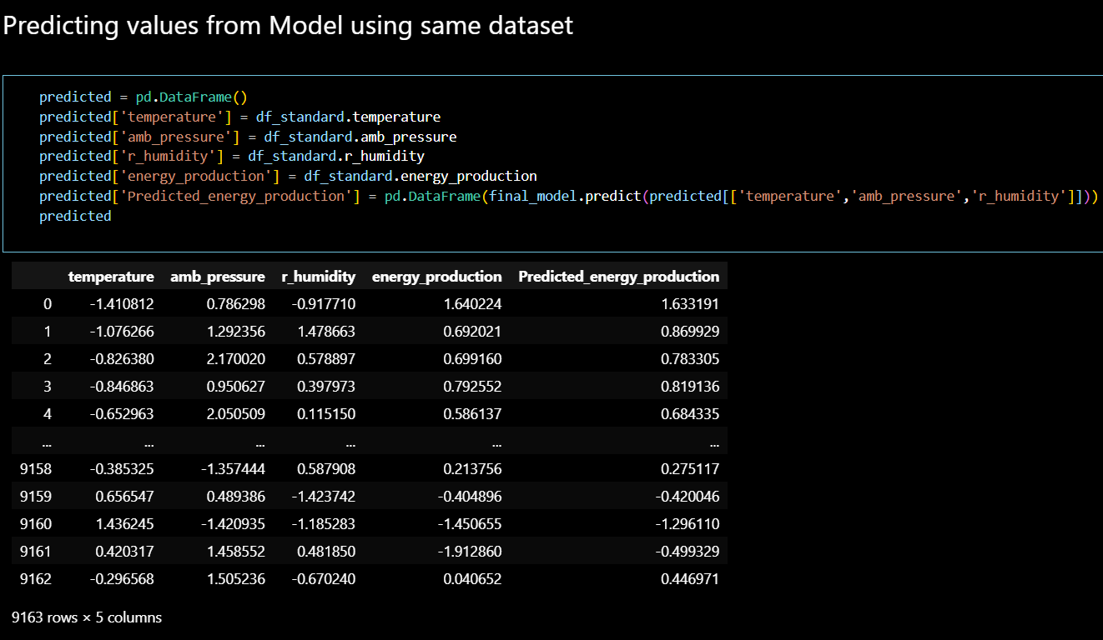
Predicting values from Model using same dataset

Slide 30
Final Model Selection
The Final model that would be used for the future predictions is Random Forest Regression Model as it has shown the highest r square value among all the 4 model we had tested our data on.
Random forest regression con often be more accurate then linear regression for modelling.
Further this model will be used for the deployment.

Slide 31
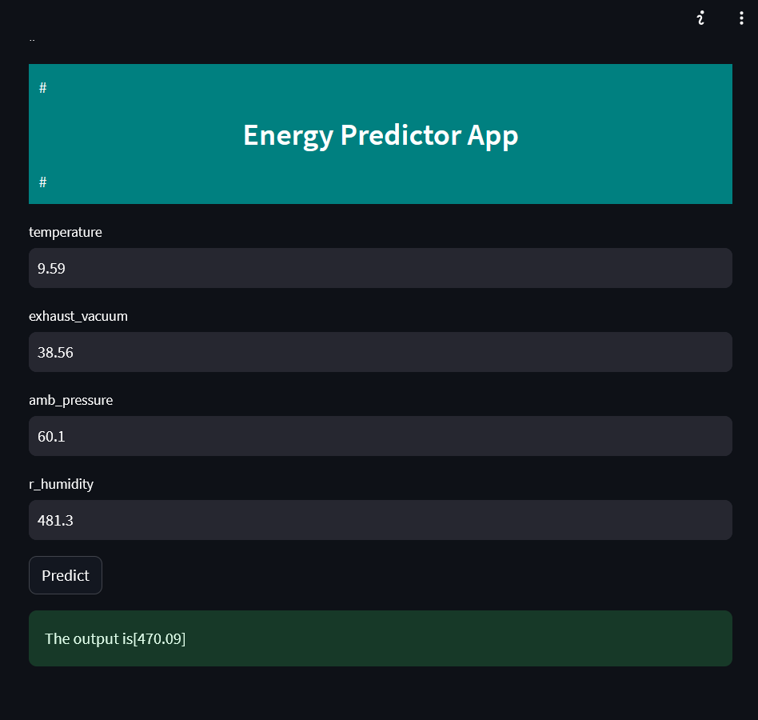
Deployment

Slide 32
Challenges:
Values are independently corelated with each other so its difficult to get relation
We have so many models so its hard to select from them, for selecting model we check accuracy of each and after checking accuracy we selected Random Forest Regression Model.

Slide 33
Conclusion
We fulfill the objective of the analysis by building a model of Random Forest to predict the energy production from variables into the account and thereby increase the efficiency of the power plant

Slide 34
THANK YOU

